Slide 1


Problem Solving with C laboratory UE19CS152 Lab miniproject:2019-2020
“Hospital Management System”
*Team members:
1) Sumukh Raju Bhat
2) Anush D
3) G Vamsi Krishna
4) Prem Kumar L
*Guide Name:
Prof.Supreetha

Slide 2
INTRODUCTION:
A digitalized effort to reduce a hospital’s front desk burden.
A step towards reducing paperwork and maintaining efficient order in data access and financial management.
A decent user-interface for the same.

Slide 3
Operations involved:
mainscreen()=>clear the screen and border the screen with *’s.
newrecord()=>scan name,age,address,gender,specialist,room etc
newrecord1()=>scan the tests and their fees.
editrecord()=>access to edit record via switch1() when pressed ‘1’.
switch1()=>when pressed ‘1’ to edit test/doctor/catogory or deposit
print()=>display all the scanned and maintained data.
bill()=>Financial care:total fee,balance,to be paid/returned,test fee
displaydepartment()=>display all the specialists and their room no
displaytest()=>display all the tests and their fees.
’delete’ records in main().

Slide 4
LETS TAKE A LOOK AT CODE EXECUTION….

Slide 5
LEARNING OUTCOMES:
Integrate all the concepts of record management into a simple program.
Decent user-interface in c-programming language.
String sorting in a particular order from a file.
Using file as a database of a large variety of data.
Michellaneous file operations and file pointer manipulations.
Overview of database management with known information in C-programming language.
Financial management of data.

Slide 6
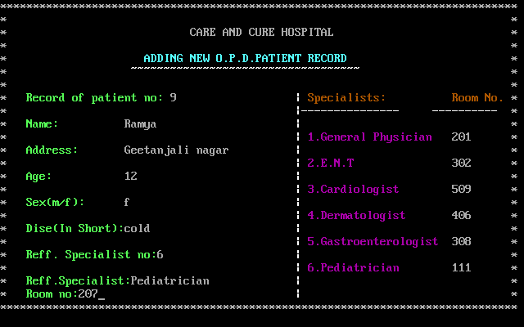
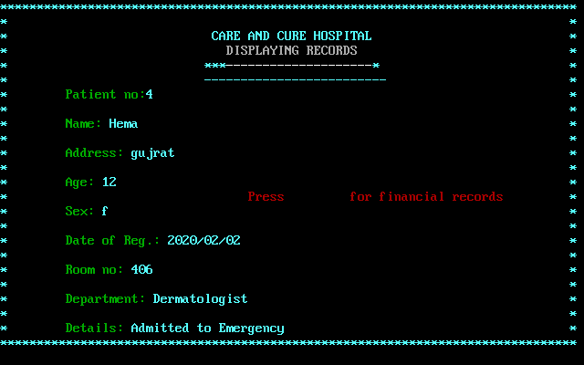
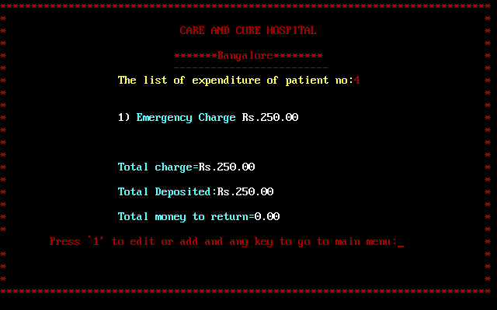
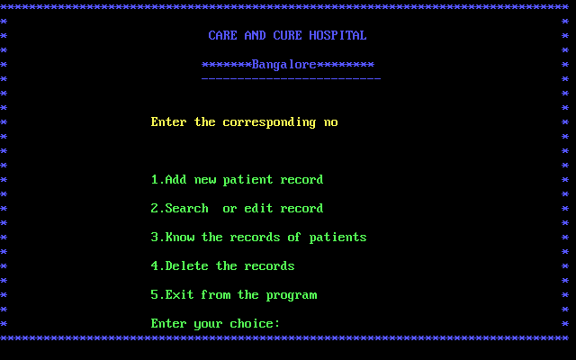
OUTPUT SCREENSHOTS:

Slide 7
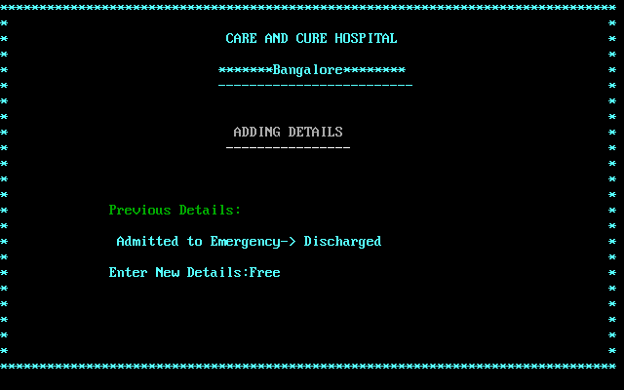
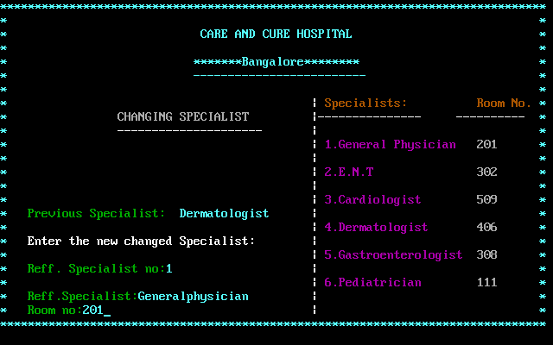
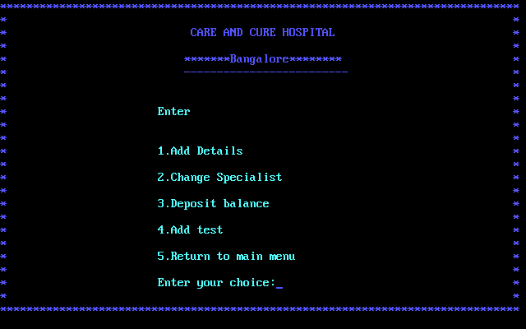
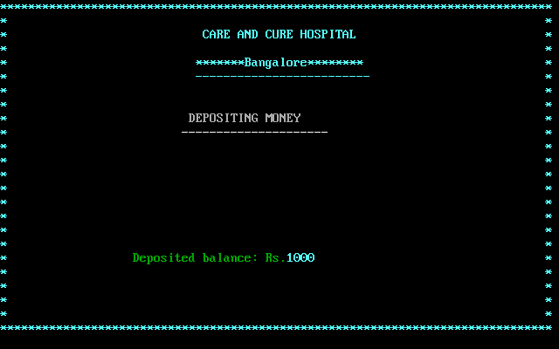
OUTPUT SCREENSHOTS:

Slide 8
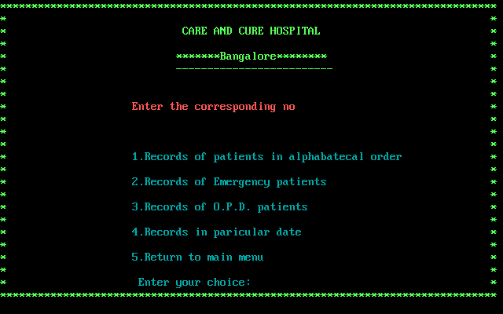
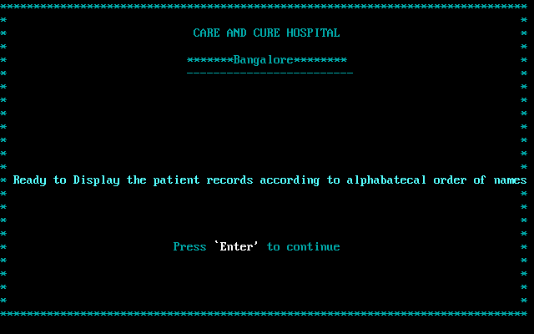
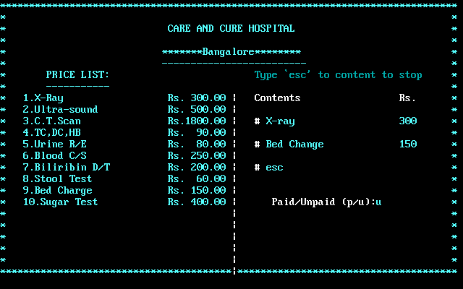
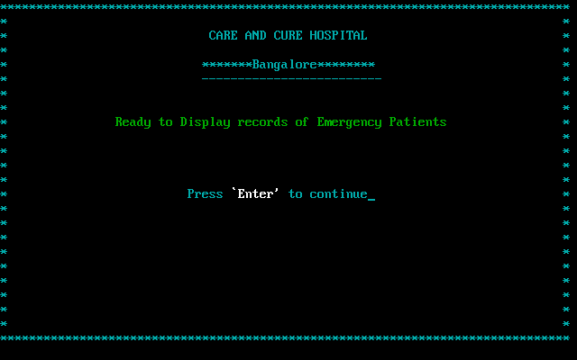
OUTPUT SCREENSHOTS:

Slide 9
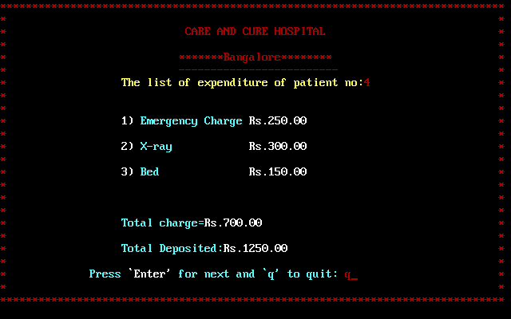
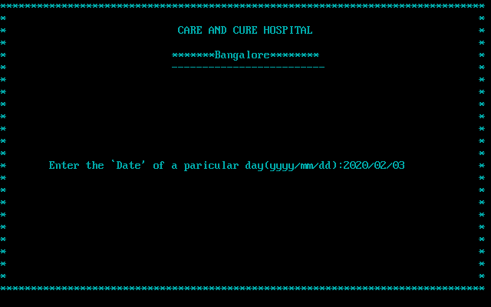
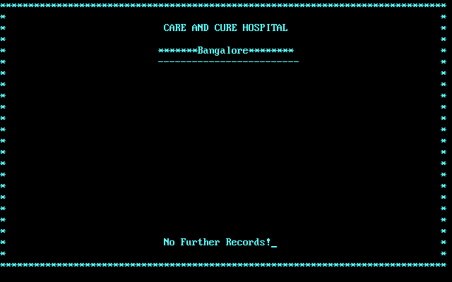
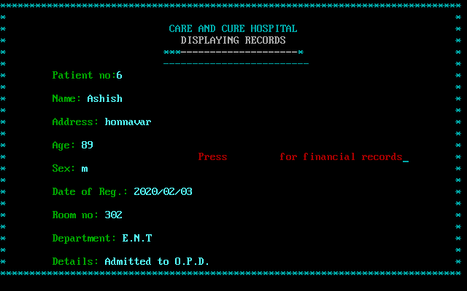
OUTPUT SCREENSHOTS:

Slide 10
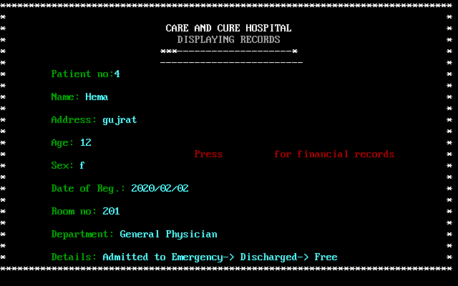
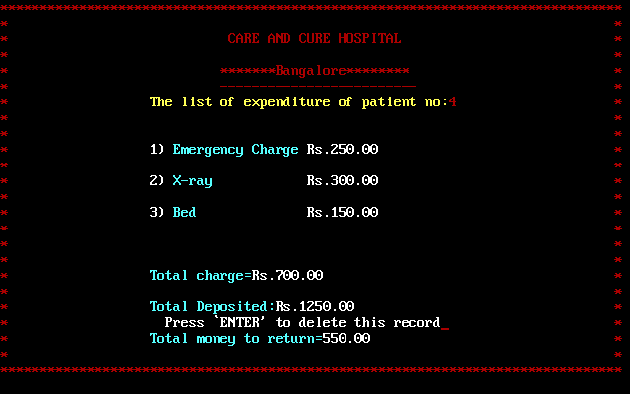
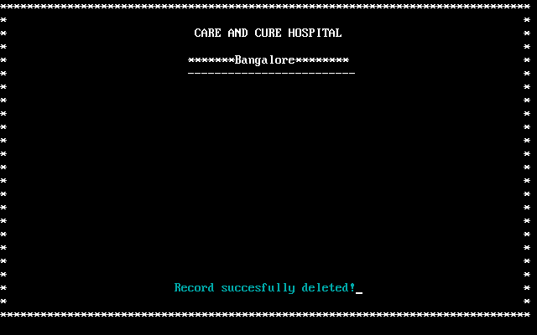
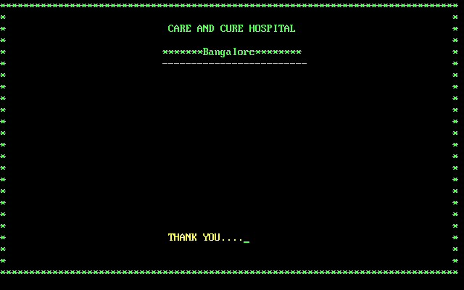
OUTPUT SCREENSHOTS:

Slide 11
THANK YOU……….

